Slide 1
Microprocessor Architecture ECE4375
Dr. Argenis Bilbao
Spring 2024

Slide 2
Presentation Outline
Memories

Slide 3
Memories
Random Access Memory
Different flavors at different levels
  Physical Makeup (CMOS, DRAM)
  Low Level Architectures (FPM,EDO,SDRAM,RAMBUS)
Cache uses SRAM: Static Random Access Memory
  No refresh (6 transistors/bit vs. 1 transistor
  Size: DRAM/SRAM - 4-8x, Cost and
  Cycle time: SRAM/DRAM - 8-16x
Main Memory is DRAM: Dynamic Random Access Memory
  Dynamic since needs to be refreshed periodically (8 ms, 1% time)
  Addresses divided into 2 halves (Memory as a 2D matrix):
    RAS or Row Access Strobe
    CAS or Column Access Strobe

Slide 4
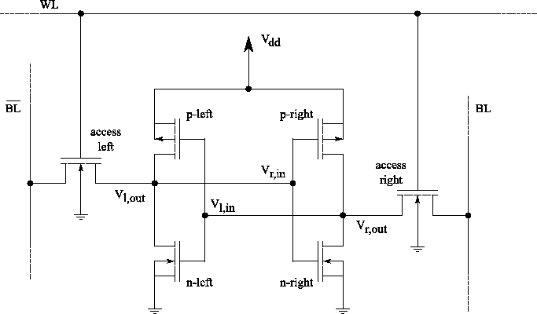
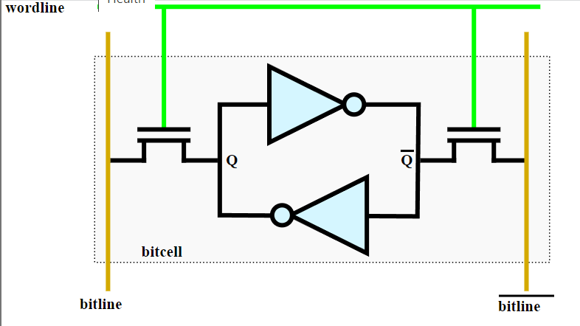
Static RAM (SRAM)
Six transistors in cross connected fashion
  Provides regular AND inverted outputs
  Implemented in CMOS process (SEE DATASHEET)

Slide 5
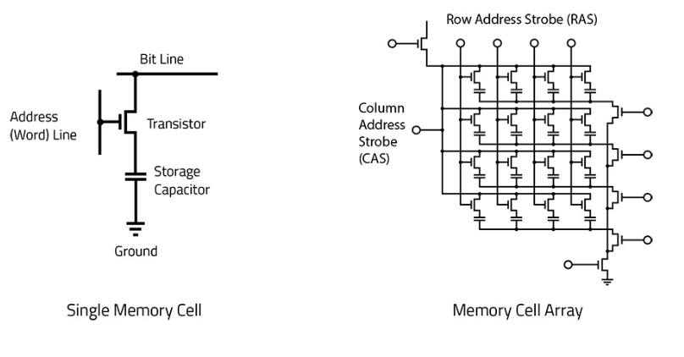
Dynamic RAM (DRAM)
SRAM cells exhibit high speed/poor density
DRAM: simple transistor/capacitor pairs in high density form

Slide 6
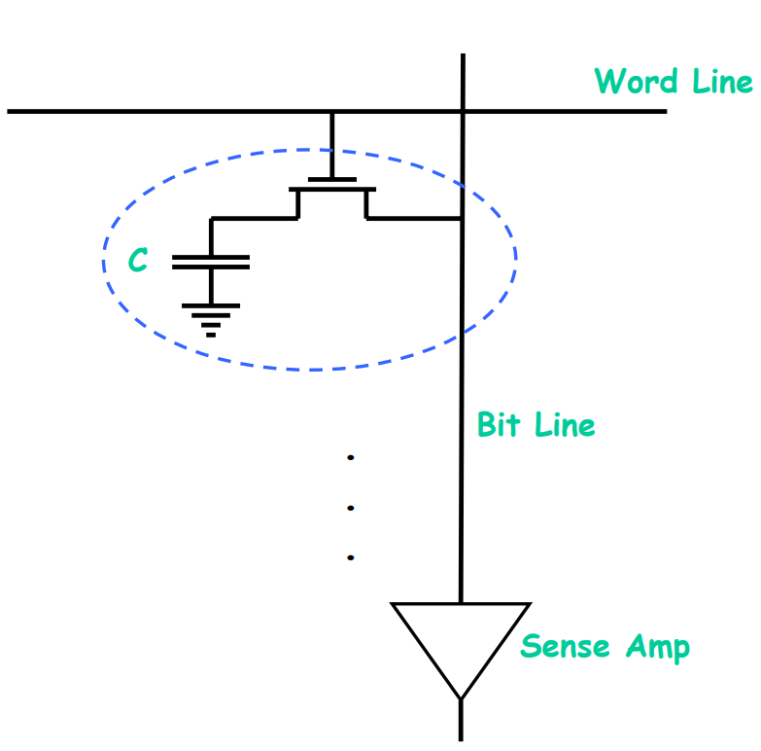
DRAM Operations
Write
  Charge bitline HIGH or LOW and set wordline HIGH
Read
  Bit line is precharged to a voltage halfway between HIGH and LOW, and then the word line is set HIGH.
  Depending on the charge in the cap, the precharged bitline is pulled slightly higher or lower.
  Sense Amp Detects change
Reads are destructive (Must follow with a write)
Must refresh capacitor every so often

Slide 7
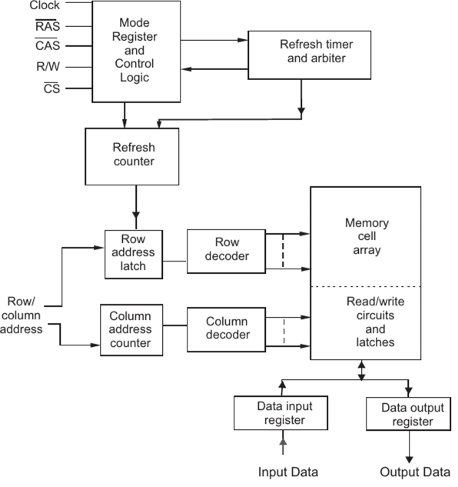
DRAM Operations
Square Row/Column Matrix
Multiplexed row/column address lines to save pins
Internal Row Buffer
How to address:
Put Row Address on Lines
Set RAS line
Read row into row buffer
Put Column Address on Lines
Set CAS line
Read Column bits

Slide 8
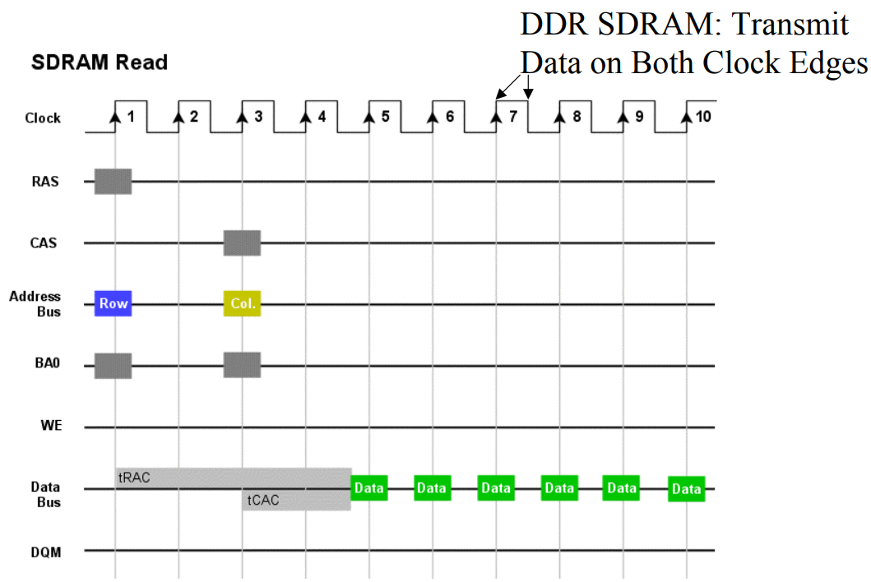
Synchronous DRAM

Slide 9
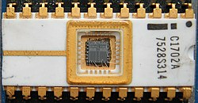
EPROM
Erasable Programmable Read-only Memory (EPROM)
Can be written to through the application of “higher than normal” voltage levels to the device.
Can be erased by the application of very strong ultraviolet light to the semiconductor chip.
Can be accessed randomly
read/write (just like SRAM)
Had endurance problems!
Cannot be purchased
anymore
Early 1970’s technology

Slide 10
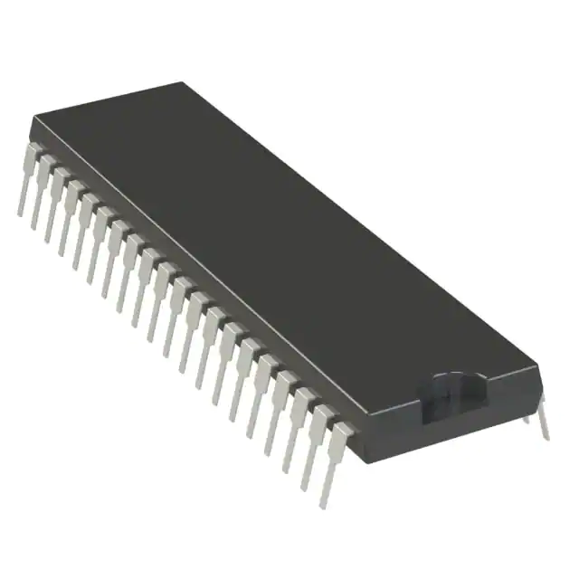
EEPROM
Electrically Erasable Programmable Read-only Memory (EEPROM)
Can be written to through the application of “higher than normal” voltage levels to the device
Can be erased electrically
Can be accessed randomly read/write
(just like SRAM)
Can still be purchased
Late 1970’s technology

Slide 11
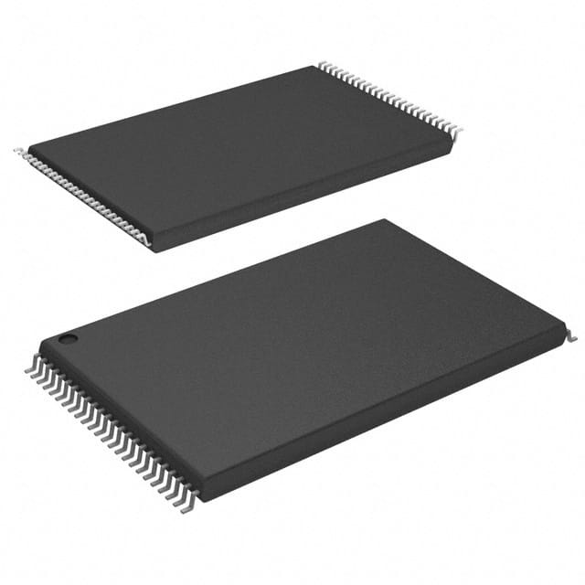
What is Flash Memory?
Non-volatile computer storage memory
  Non-volatile: Power removal does not cause data loss.
  Volatile: Power removal causes data loss/corruption.
Derived from the EEPROMs
Used for camera storage media, phones,
USB drives, SSDs, etc.
Late 1980’s technology

Slide 12
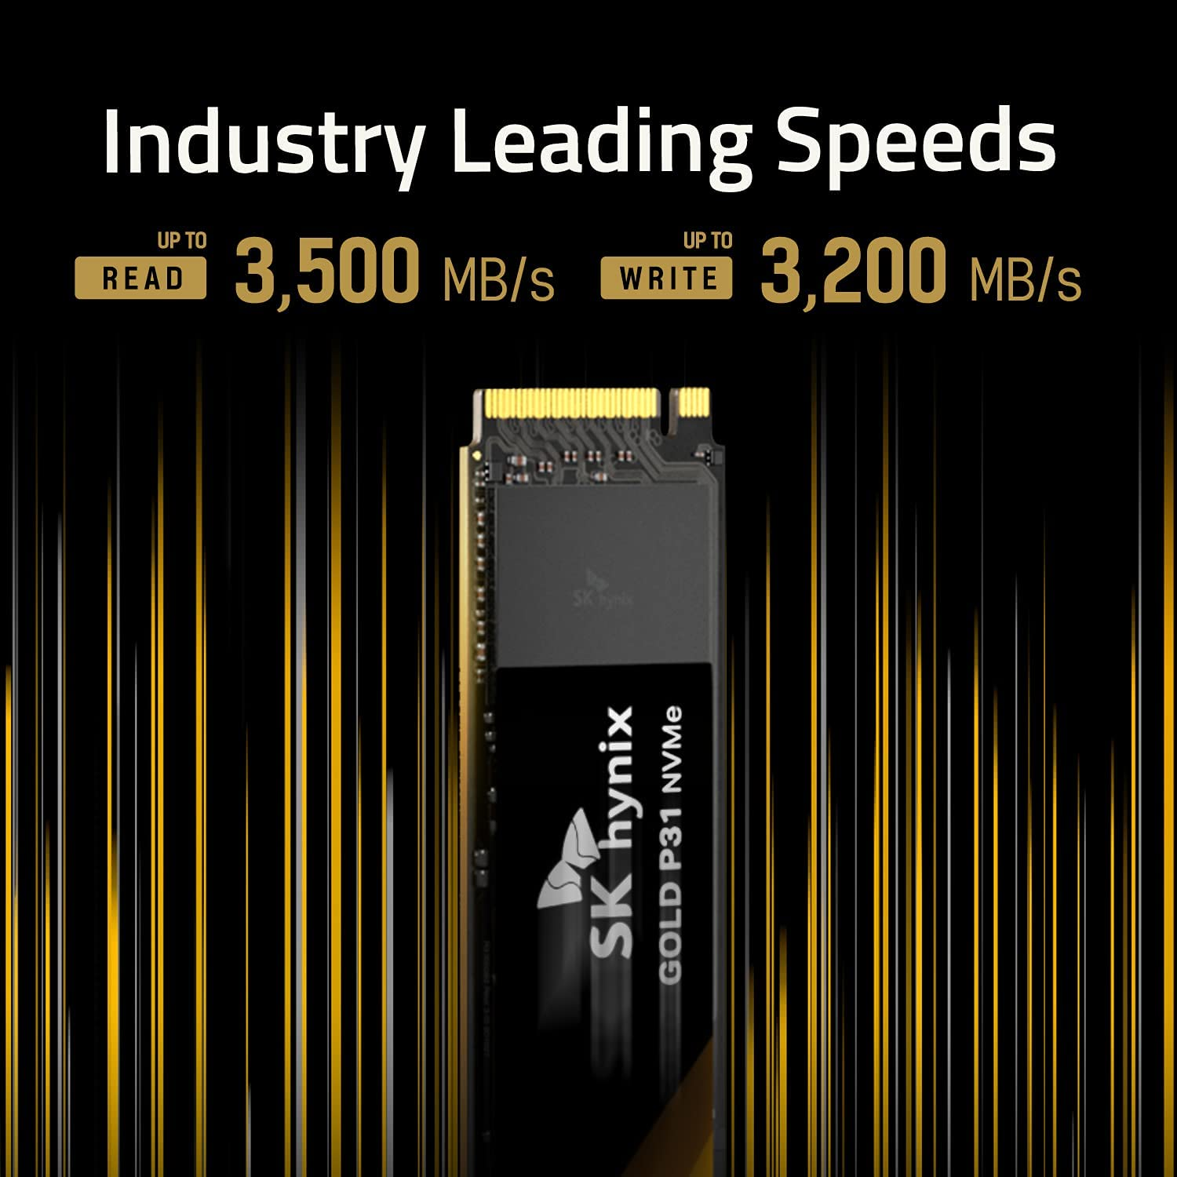
What is Flash Memory?
Can be read in 4Kb to 16 Kb blocks
Writes are more complicated
Bits can be electrically erased
When erased the bits read 1’s
Writing of a bit sets the required bits to 0’s
A single byte write requires erasing an entire
“page”, which is made of multiple blocks
Data that we didn’t mean to change needs
to be rewritten to the rest of the page

Slide 13
Sources
http://www.eecs.harvard.edu/cs146-246/
Assigned Textbook
https://www.javatpoint.com/functional-units-of-digital-system#:~:text=Functional%20units%20are%20a%20part,for%20by%20the%20computer%20program.
https://en.wikichip.org/wiki/File:sram_basic_cell.svg

